Slide 1
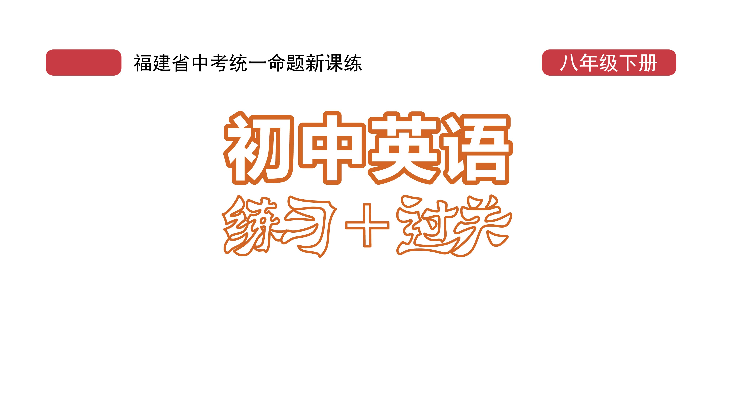
课时练习
模块六 第一章 第四节

Slide 2
一、翻译下列词组。
1. 安全着陆 ______________________
2. 第二天 ________________________
3. 在第三天 ______________________
4. 到达顶部 ______________________
land safely
the next day
on the third day
get to the top

Slide 3
二、用括号内所给单词的适当形式填空， 每空不限词数。
1. The most important thing during an earthquake is ______________ (stay) calm.
2. Listen! There’s __________ (anybody) knocking on the door.
3. A ________ (sleep) is a train with beds for its passengers(乘客) to sleep in at night.
staying/to stay
somebody
sleeper

Slide 4
二、用括号内所给单词的适当形式填空， 每空不限词数。
4. Since 2011, the Beijing-Shanghai high-speed railway has transported(输送) over 1.35 billion passengers ________ (safe).
5. Even if the working ___________ (condition) are terrible, the robots(机器人) can still work perfectly.
safely
conditions

Slide 5
二、用括号内所给单词的适当形式填空， 每空不限词数。
6. The historic feeling of the town makes it a _________ (pleasure) place to visit.
7. The woman didn’t know where _______ (buy) a dress she needed.
8. Some teachers find it difficult _________ (keep) their classes in order.
pleasant
to buy
to keep

Slide 6
二、用括号内所给单词的适当形式填空， 每空不限词数。
9. Zhang Guimei spends most of her life ________ (work) as a teacher.
10. My clock didn’t work _________ (proper) this morning. That’s why I’m late.
working
properly

Slide 7
三、单项选择。
( )1. Most of these old buildings are not fit ______.
A. to live in B. live in C. living in
A

Slide 8
三、单项选择。
( )2. The poor man can’t _______ anything in his life that is going right.
A. think of B. think about C. think over
A

Slide 9
三、单项选择。
( )3. Amy was surprised to find that a cute bird _______ on her head.
A. walked B. landed C. dropped
B

Slide 10
三、单项选择。
( )4. Chinese climbers ________ the top of Mount Qomolangma on May 27, 2020.
A. came B. arrived C. got to
C

Slide 11
三、单项选择。
( )5. —I’ll go on a visit to the Palace Museum(故宫博物院).
—________.
A. Never mind B. Have a good trip
C. My pleasure
B

Slide 12
四、结合本话题的重点语法， 根据提示词翻译下列句子。
1. Jim的梦想是成为一名科学家。(dream, to be)
_____________________________________
2. 这个医生每天都有很多工作要做。(to do)
_____________________________________
Jim’s dream is to be a scientist.
The doctor has much work to do every day.

Slide 13
四、结合本话题的重点语法， 根据提示词翻译下列句子。
3. 学好物理对有些学生来说很难。(it’s, learn)
________________________________________
________________________________________
4. 我们的老师邀请了王先生为我们做演讲。(invite, speech)
____________________________________________
It’s very difficult for some students to learn physics well.
Our teacher invited Mr. Wang to give us a speech.

Slide 14
四、结合本话题的重点语法， 根据提示词翻译下列句子。
5. 你能告诉我如何使用这台电脑吗？(how to)
________________________________________
Could you tell me how to use this computer?

Slide 15


